Slide 1


UNIT 1; All about me
Self-check 1

Slide 2
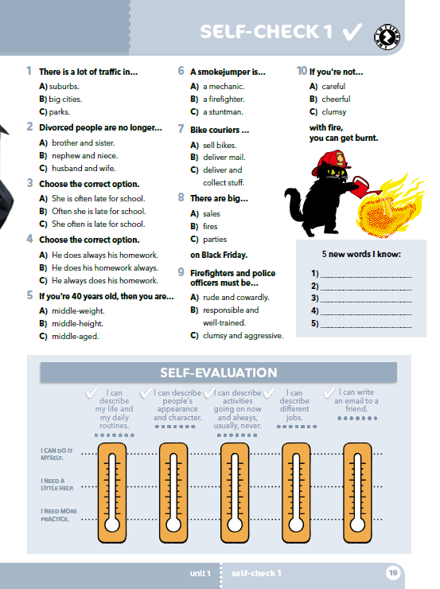
.

Slide 3
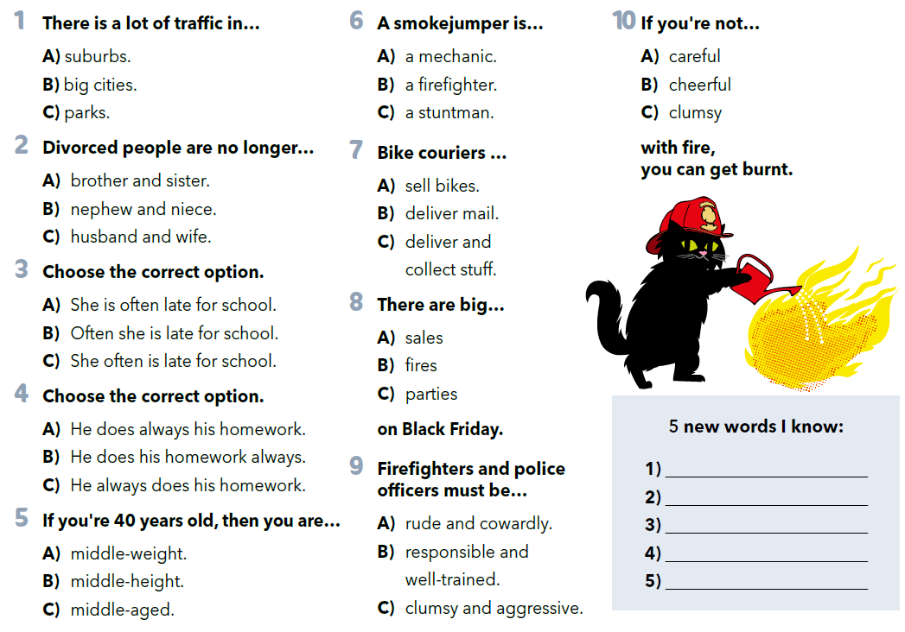


Read the questions and circle the correct answer.
Write 5 new words you know.

Slide 4
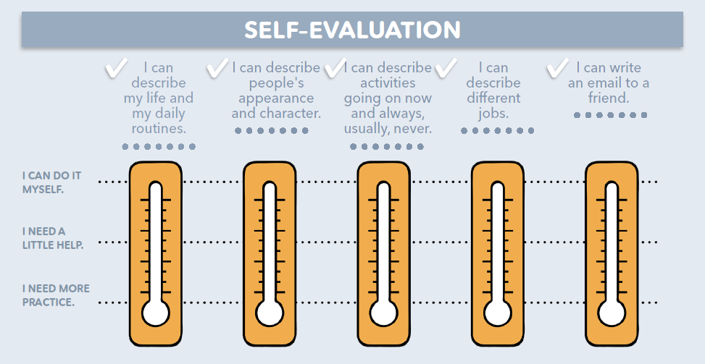
mogu sam, jasno mi je
trebam malo pomoći
moram još vježbati

Slide 5
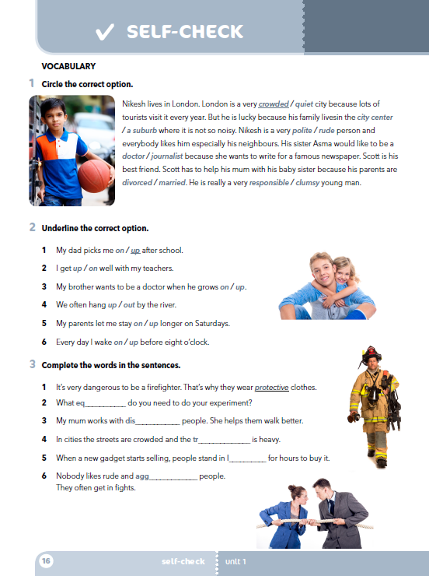
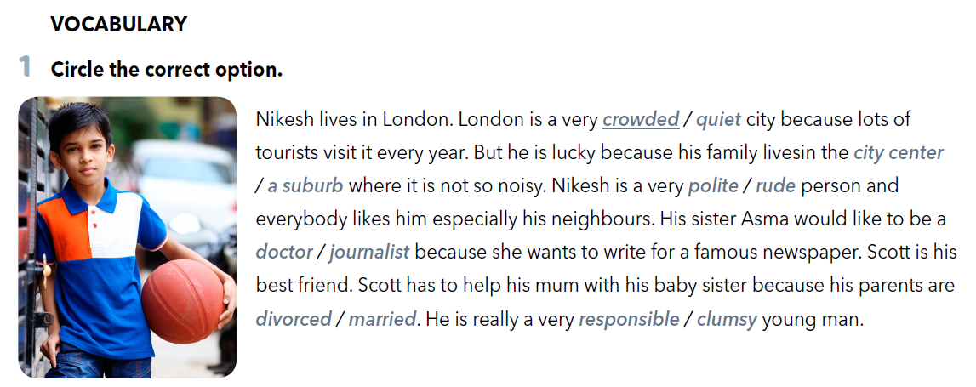

Slide 6
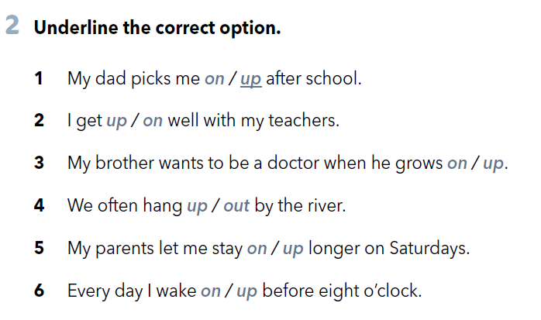


Slide 7
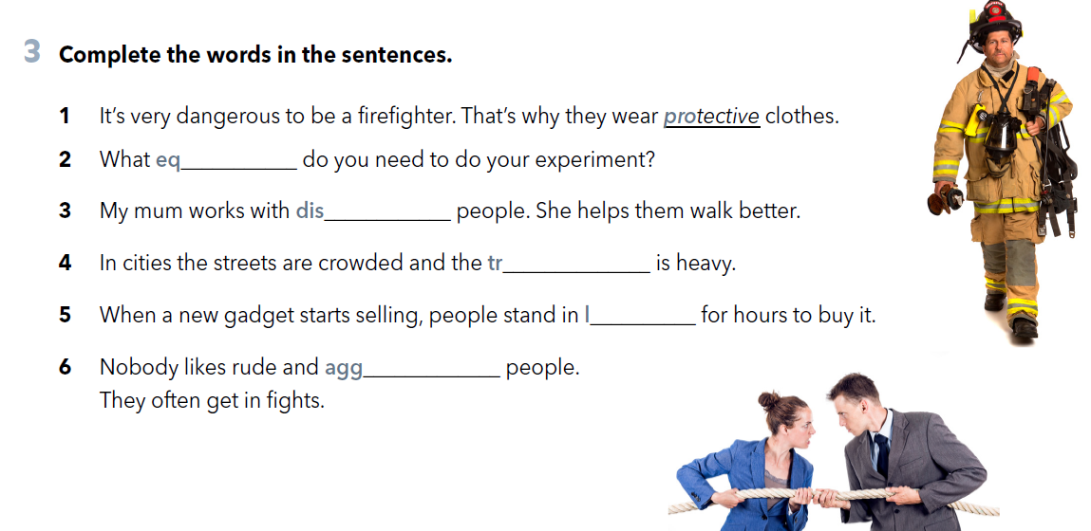
uipment
abled
affic
ine
ressive

Slide 8
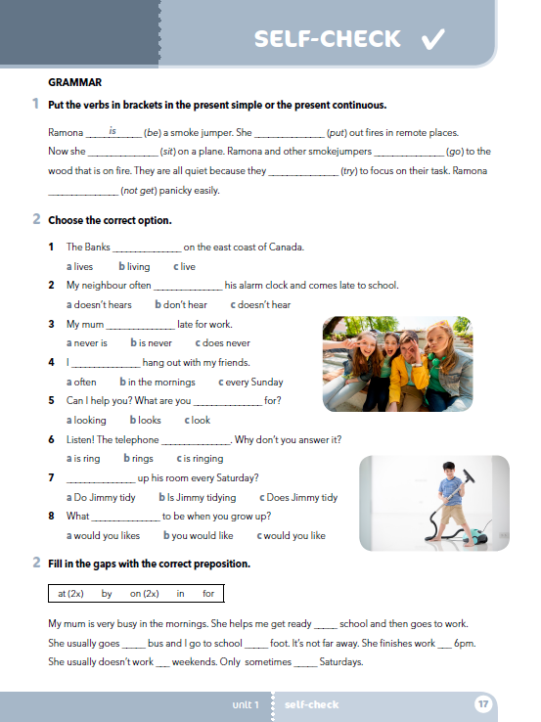
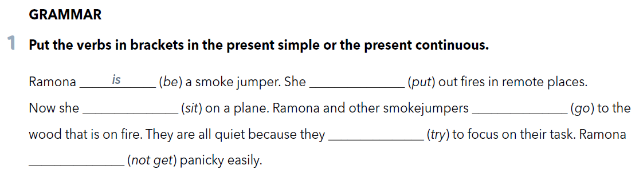
puts
Sada
is sitting
are going
are trying
doesn’t get

Slide 9

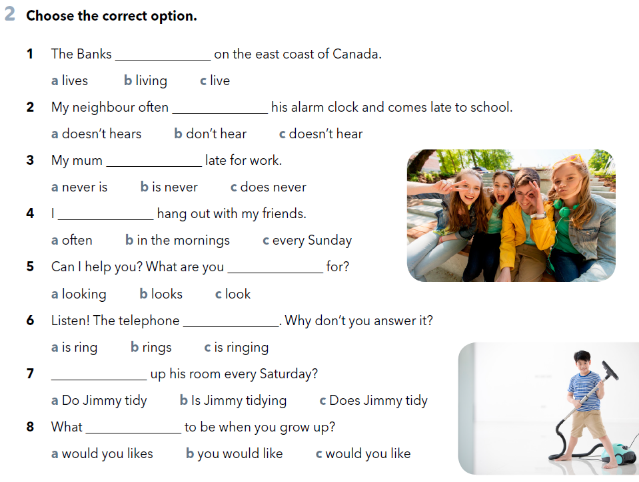

Slide 10
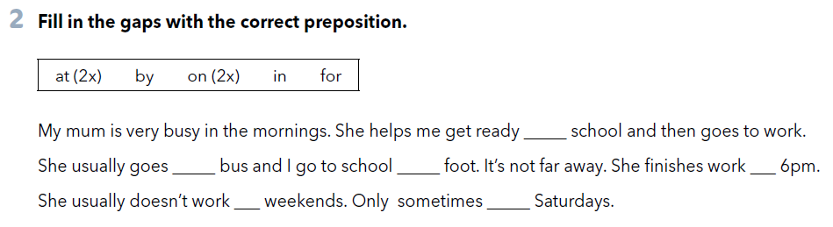
for
by
on
at
at
on
Let’s revise: https://www.e-sfera.hr/dodatni-digitalni-sadrzaji/420939a4-ca9c-49e5-ab61-a2c87f283b87/

